Slide 1
Strategic Information Systems Management Section 11 Managing IT-based risk, Building better IT leaders from the bottom Class Code: COMP423 H.Y Kan, Stanley Room: (WUI CHI) - 4/F, N46B Email: hykan@ipm.edu.mo Tel: 8599-6883

Slide 2
Introduction
This section will focus on the following issues:
IT governance
Holistic risk management
Risk management framework
Ethics
Security

Slide 3
IT Governance
One of the key duties of the CIO is IT governance.
According to IT Governance Institute, IT governance is a board or senior management responsibility, in relation to IT, to ensure that:
IT is aligned with the business strategy, or in other words, IT delivers the functionality and services in line with the organization’s needs, so the organization can do what it wants to do;
IT and new technologies enable the organization to do new things that were never possible before;
IT-related services and functionality are delivered at the maximum economical value or in the most efficient manner. In other words, resources are used responsibly; and
All risks related to IT are known and managed and IT resources are secured.

Slide 4
Importance of Managing IT-based Risk
IT is now affecting almost every aspect of a business. It is important to manage IT-based risks to avoid service disruption, loss of reputation or legal liabilities.
Not every risk affecting an enterprise with be an IT-based risk, but a large number of risks affecting the enterprise have an IT-based component.
Risk management is perennially the top ten priorities for CIOs and efforts are being made to put effective capabilities and processes in place in IT organizations.

Slide 5
Importance of Managing IT-based Risk
The top ten priorities for CIOs:
Cybersecurity & risk management
Digital Government / Digital Services
Cloud Services
Broadband / Wireless Connectivity
Budget, Cost control, Fiscal management
Data management and analytics
Consolidation / Optimization
Identify and access management
Workforce
Customer Relationship Management

Slide 6
A Holistic View of IT-based Risk
IT leaders agree that IT-based risk must be dealt with holistically. However, it can be difficult because…
Every category of risk has a different vocabulary – financial, software, information security, disaster recovery planning, governance legal.
Risk is often managed in silos in organizations, resulting in uncoordinated approaches to its management and to decision-making incorporating risk.
The connection among all of the different risk perspectives is the enterprise. A holistic view must put the enterprise front and center in any framework.

Slide 7
A Holistic View of IT-based Risk (Cont’d)
A risk to the enterprise include anything that affects its:
Brand
Reputation
Competitiveness
Financial value
End state (i.e., its overall effectiveness, efficiency, and success)

Slide 8
A Holistic View of IT-based Risk (Cont’d)
External Risk
Legal/Regulatory Hazards Third Parties
Enterprise Risk
Criminal Interference
Internal Risk
Operations Information System Development
People Processes Controls Culture Governance

Slide 9
Holistic Risk Management: A Portrait
Characteristics and components of a portrait of effective, holistic risk management:
Focus on what is important: Risk management is not about anticipating all risks but about attempting to reduce significant risks to a Manageable Level (ML) and knowing how to assess and respond to it.
Expect the risk management approach to change over time: Since IT is evolving, risk management should also be continuous and iterative. When incidents occur, there should always be a process for evaluating what happened, assessing its impact and determining if controls or other management processes need to be adapted.
View risk from multiple levels and perspective: Enterprises should not only focus on the Operational and Tactical Levels of risk management. Risk management should also be viewed in a strategic way. “We need to assess risk trends and develop strategies for dealing with them.” “We must aim for redundancy of protection – that is, multiple layers, to ensure that if one layer fails, others will catch any problems.”

Slide 10
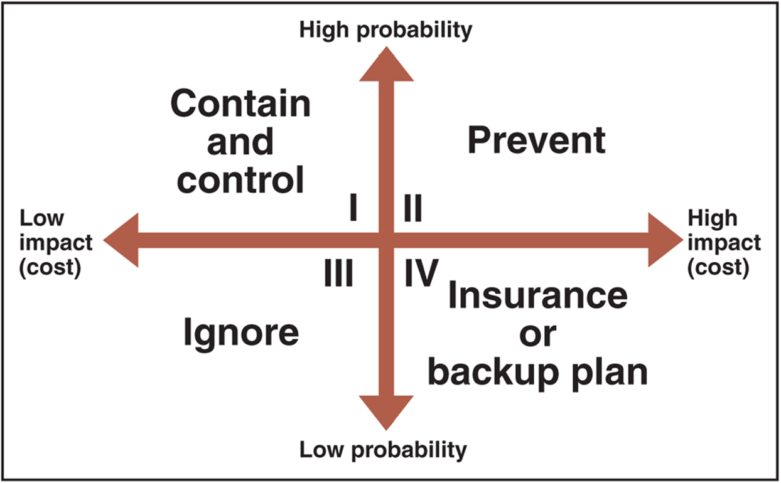
Holistic Risk Management: A Portrait (Cont’d)
© Cengage Learning 2017
FIGURE 10-1 Risk management model

Slide 11
Developing a Risk Management Framework
With the big picture in mind, organizations can begin to develop a framework for filling in the details. The objective of a Risk Management Framework (RMF) is to create a common understanding around risk, to ensure the right risks are being addressed at the right levels, and to involve the right people in making risk decisions.
A basic RMF includes the following:
Policies and standards: These state the general principles for guiding risk decisions and identify any informal corporate, industry, national, or international standards that should apply to each risk category.
Risk category: The general area of enterprise risk involved (e.g., criminal, operations, third party, etc.)
Risk type: Each type of risk associated with each category. Each type should have a generic name and definition, ideally linked to a business impact.

Slide 12
Developing a Risk Management Framework (Cont’d)
A basic RMF includes the following (cont’d):
Risk ownership: Each type of risk should have an owner, either in IT or in the business. The risk owner makes decisions related to the risk.
Risk mitigation: Each type of risk should be associated with controls, practices and tools for addressing it effectively.
Risk reporting and monitoring: Risk and its management should be made more visible in the organization. However, tracking and reporting risk can make organizations highly risk averse.

Slide 13
Improving Risk Management Capabilities
Several actions that could lead to effective risk management capabilities:
Look beyond technical risk
Develop a common language of risk
Simplify the presentation
Right size
Standardize the technology base
Rehearse (“security drilling”)
Clarify roles and responsibilities
Automate where appropriate
Educate and communicate

Slide 14
Types of Security Threats
Key aspects of information security: Confidentiality, Integrity and Availability (the “CIA”)
Types of security threats:
Human errors
Denial of service or distributed denial of service attacks
Malware (e.g., spyware, Trojan horses, viruses and worms)
Social engineering
Spam
Phishing

Slide 15
Counter measures
Access control:
Password, security tokens, biometrics, physical controls
Authorization: controls a specific user’s right to access information systems.
Encryption
Firewall
Intrusion detection systems
Security policies
Risk management
Education, Awareness, Training

Slide 16
Ethical Behavior in IT/IS
A past survey has reported that 57% of the IT workers have been asked to do something “unethical” by their supervisors, e.g.,
using unlicensed software,
accessing personal information, and
divulging trade secrets to competitors.
Ethics is about the personal and public judgement as to what is desirable and undesirable, right and wrong and what we ought and ought not do.

Slide 17
Ethical Behavior in IT/IS (Cont’d)
Ethical management tends to be more devolved with style varied according to sector and purpose.
Deontic ethics – the theory that denies consequences as the sole source of moral value and refers instead to absolute rules or principles of virtue, right or duty, e.g., Immanuel Kant.
Utilitarian ethics – the theory that claims that the only legitimate principle upon which to judge an action as ethical is that it has beneficial consequences: namely, that it reduces harms and promotes the greatest happiness of the greatest number, e.g., John S Mill. “The greatest happiness principle.” What is right and wrong is determined solely on the outcomes/consequences of one action/policy over others.
Virtue ethics – the theory that ethical conduct should be directed by ideals of the virtues higher than conformity to standards set by duty and law.
Morals are the actual values (ethical preferences) and norms (rules and principles) that an individual or body accepts as guidance for their practices.

Slide 18
Factors Affecting Moral Behavior
Social norms
E.g., piracy rates are different in different countries partly because of culture.
Related to IT: professional organizations and codes of ethics
Law:
E.g., stealing is punished by the law.
Related to IT: Copyright law, privacy law, etc.
Economics:
E.g., shoppers need to pay for plastic bags in Hong Kong.
Related to IT: 四電一腦 - 廢電器計劃

Slide 19
Professional Organizations and Codes of Ethics
An effort to affect behavior by social norms.
Many professional organizations have a code of ethics that all members pledge to uphold, e.g., Code of Ethics and Professional Conduct by ACM (Lecture 13).
The Code of Ethics and Professional Conduct consists of 24 statements of personal responsibilities in four main categories:
Fundamental ethical considerations
Specific considerations of professional conduct
Considerations for individuals in leadership roles
Compliance with the code

Slide 20
Legislation
Examples:
The European Union (EU) Directive on Data Protection of 1995
The United Kingdom’s Data Protection Act of 1998
The Computer Misuse Act 1990

Slide 21
Intellectual Property
Copyright: is a right granted by government to the author (creator) of literary or artistic work
Gives author (creator) sole and exclusive right to the work (print, publish, sell) for a specific length of time
Includes virtually all forms of artistic or intellectual expression
Idea contained in an expression cannot be copyrighted (for example, mathematical calculations)
Collection of facts can be copyrighted if arrangement rises to level of an original work
Example: Yahoo! Web Directory

Slide 22
Intellectual Property (Cont’d)
Patent is an exclusive right granted by government to an individual to make, use, and sell an invention
Protection for 20 years in the United States or inventor can patent the design for 14 year
Invention must be genuine, novel, and useful
Not obvious given current technology state
Software patents not considered useful because technology obsolete before patent protection secured
Process is expensive and takes several years

Slide 23
Intellectual Property (Cont’d)
Trademark is a distinctive mark, device, motto, or implement that a company affixes to goods it produces for identification purposes
Service mark identifies the services provided
Registered with governments (state and/or federal)
Web site designers must not use any trademarked name, logo, or other mark without permission.

Slide 24
Leadership Is Everyone’s Job
“Effective leadership has enormous
benefits. To realize these benefits,
leadership qualities should be explicitly
recognized, reinforced, and rewarded
at all levels of the IT organization.” (McKeen and Smith, 2003)

Slide 25
Why Is the IT Organization a Hierarchy?
Little Pressure to Change
Organization that IT is a Part of is Hierarchical
Senior Executives have Difficulty Relinquishing Control

Slide 26
Transformational IT Leadership Requires …
Top-Line Focus – New technologies and applications drive the enterprise to differentiation and transformation strategies to deliver top line growth. Strong IT leadership teams are needed to take on roles to influence business leaders.

Slide 27
Transformational IT Leadership Requires … Continued
Credibility – IT must consistently deliver on results. IT must demonstrate the skills and competencies to deliver what it says it will do.

Slide 28
Transformational IT Leadership Requires … Continued
Impact – IT staff must have stronger organizational perspectives, decision-making, entrepreneurialism, and risk-assessment capabilities at lower levels because even small IT decisions can have a major impact on the organization.

Slide 29
Transformational IT Leadership Requires … Continued
Flexibility – IT staff and organizations are expected to be responsive to changing business needs. IT staffs must be proactive, have strong technical skills and the ability to quickly act in the best interests of the organization when the need arises.

Slide 30
Transformational IT Leadership Requires … Continued
Complexity – IT is expected to offer change and innovation leadership, low-cost services and lead the way through ever changing new technology opportunities.

Slide 31
Transformational IT Leadership Requires … Continued
New Technology – Staffs are increasingly mobile and their interactions with their managers are mediated by technology. New technologies change how information is acquired and disseminated, how communication takes place, how people are influenced and decisions made.

Slide 32
What Makes a Good IT Leader?
Personal Mastery
Self-knowledge
Leadership Skill Mastery
Motivation & Team Building
Awareness of individuals approaches to work
Adapt to different situations
Collaboration & Communication
Risk Assessment & Problem Solving
Coaching & Mentoring

Slide 33
What Makes a Good IT Leader? Continued
Business Understanding
Strategic Vision
Solid Understanding of Current Operations
Solid Understanding of Future Direction
Organizational Understanding
Ability to Execute Enterprise Transformation
Ability to Integrate Technology with People & Processes
Political Savvy & Effective Use of Governance Structures

Slide 34
What Makes a Good IT Leader? Continued
Creating a Supportive Working Environment
Create an Environment of Trust
Create an Environment of Accountability
Create an Environment of Empowerment
Effective Use of Resources
Ability to Concentrate on Biggest Payoff Areas
Recognize where Resources Should Not be Used
Enhance People’s Abilities

Slide 35
What Makes a Good IT Leader? Continued
Flexibility of Approach
Know where and how to exercise leadership
Adjust style to suit the situation
Ability to Gain Business Attention
Ability to articulate contributions in business terms
Ability to interact with business leaders
Ability to educate and guide business leaders in the use of technology

Slide 36
Flexible Leadership Styles (Roberts and Mingay, 2004)
Commanding – “Do What I Tell You”
Pacesetting – “Do as I Do Now”
Visionary – “Come with Me”
Affiliate – “People come First”
Coaching – “Try This”
Democratic – “What do You Think”

Slide 37
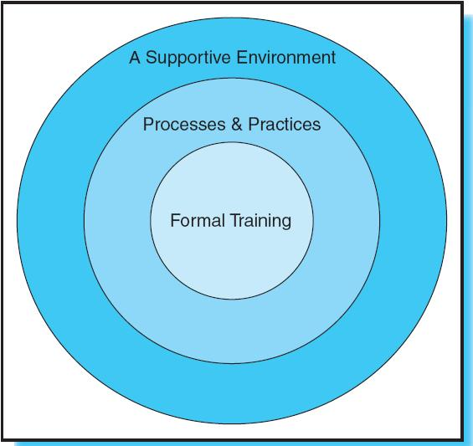
Effective Leadership Development Requires…
Figure 18.1

Slide 38
Elements of a Supportive Environment Include
Well articulated and instantiated values
A climate of trust
Empowerment
Clear and frequent communication
Accountability

Slide 39
Process & Practices
Activities such as planning, budgeting, conflict resolution, service delivery, and financial reviews should be well defined and documented
Establish job rotations and mentoring programs

Slide 40
Formal Training
Can be internally developed or externally purchased
Requires a time commitment to ensure staff can take advantage of training

Slide 41
IT Value Proposition Leadership Development Rubric
What is the value?
Who will deliver the value?
When will the value be realized?
How will the value be delivered?

Slide 42
Conclusion
Senior IT leaders must make IT leadership development a priority if IT is going to contribute to business strategy.
Management must take a comprehensive approach to integrate culture, behavior, processes, and training to deliver business value.

